Slide 1
Midterm Project
Diana Stoyanova

Slide 2
Purpose statement
The purpose of the project was to build an ETL pipeline extracting data from a transactional database (in this case Snowflake) and use the output to create an analytics dashboard over the processed data.

Slide 3
Data
The data used was provided in csv files, and uploaded to Snowflake. The files included are:
sales_mid.csv
store_mid.csv
calendar_mid.csv
inventory_mid.csv
product_mid.csv

Slide 4
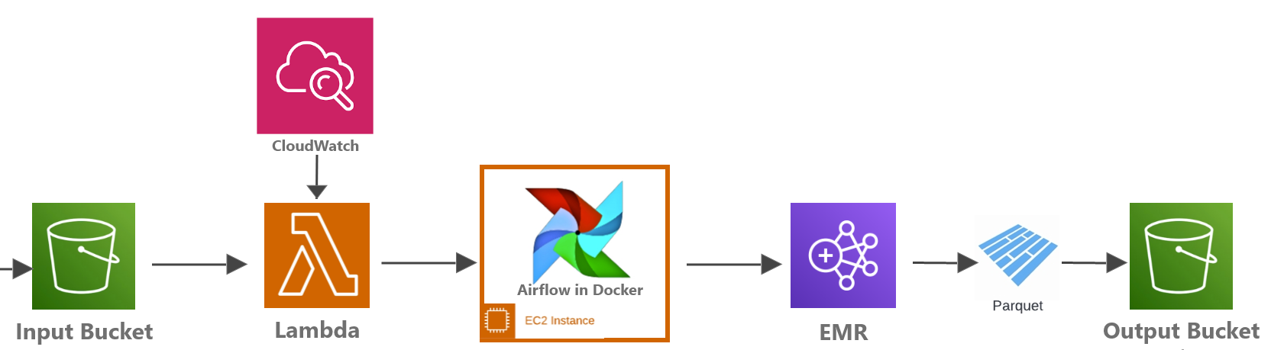
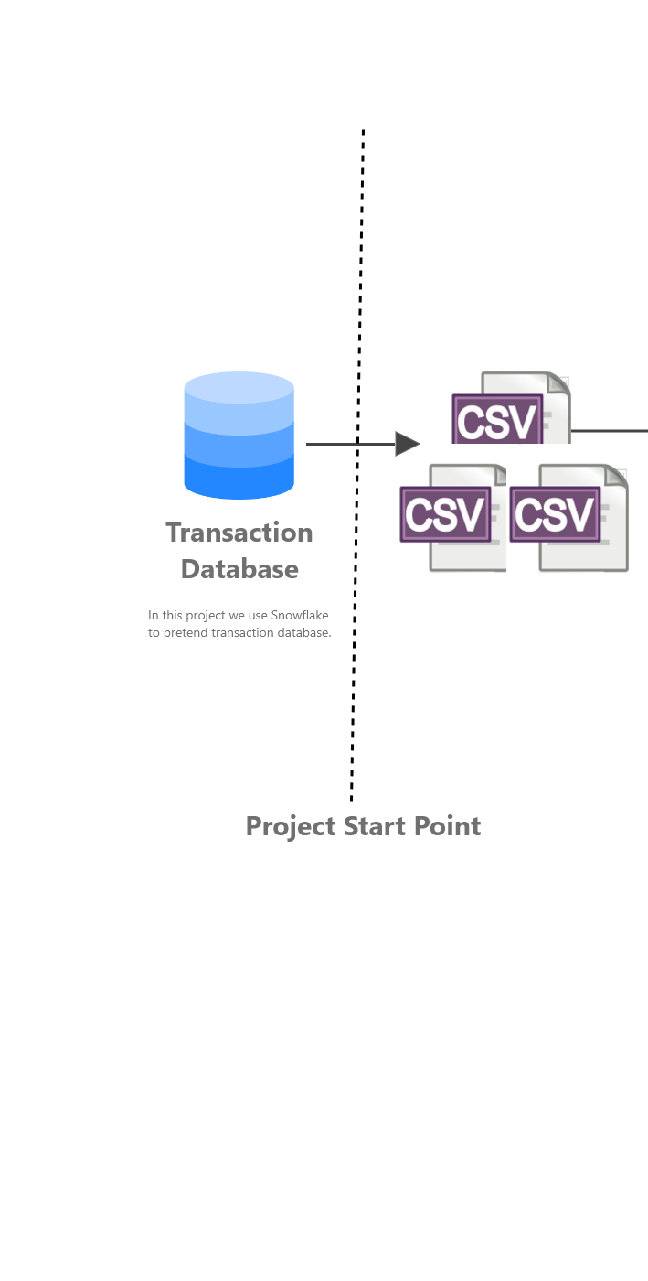
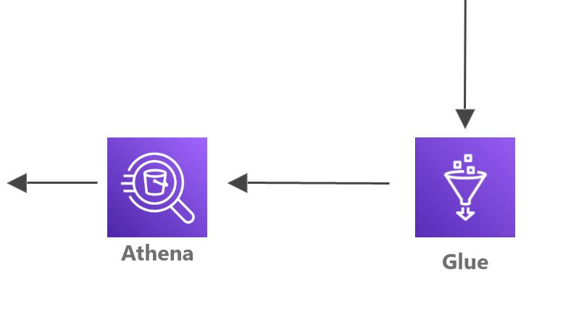
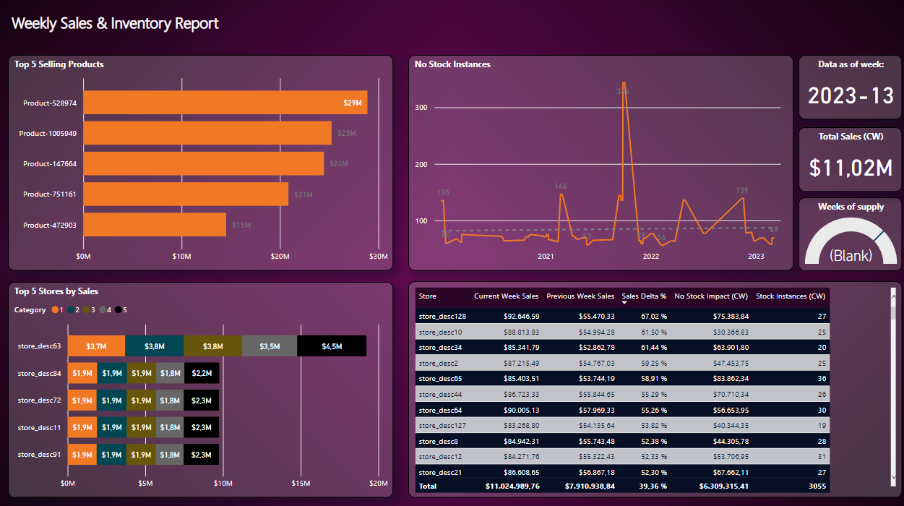

Architecture
The architecture followed is (Architecture #1):
Power BI

Slide 5
Methodology
On a high level, the architecture works as follows:
Tables from Snowflake are copied into S3 using a stored procedure and a task running in Snowflake at 2:00 AM local time
A CloudWatch event has been schedule for 3:30 AM local time to trigger lambda
The Lambda function performs a check on the file names and only if all 5 daily files are present, calls Airflow running on an EC2 instance; otherwise it sends an email notification
If Airflow gets called, a DAG run is triggered. The DAG collects the input from the Lambda (s3 file paths to the daily files) and creates an EMR cluster to run a spark job
The spark job receives the input (file paths) relayed by Airflow and does the data transformation steps and loads the final datasets into an S3 bucket, in parquet format
The airflow DAG is running and monitoring the execution of the EMR cluster for as long as that is running
The S3 bucket with the parquet files gets crawled by a Glue Crawler and tables were created in Athena based on the parquet files
Power BI then connects to Athena and imports the tables to create a dashboard

Slide 6

Access management
The Lambda function has the following permissions granted via its role: AmazonS3ReadOnlyAccess + AmazonSESFullAccess
EC2 access through IAM user with AmazonElasticMapReduceFullAccess policy attached (to create a job flow)
Glue has AWSGlueServiceRole-midterm attached, which grants S3 permissions
“Athenauser1” was created for data analysts, to enable connection from Power BI desktop to Athena (permissions: AmazonAthenaFullAccess + custom policy for limited access to S3)

Slide 7
Airflow DAG
The code defines an Airflow DAG with three tasks: parse_request, task_emr, and wait_for_completion.
The parse_request task retrieves data from S3 and passes it to the task_emr task via XCom.
The task_emr task creates an EMR job flow using Spark to run the midterm_main_v2.py script with arguments passed from the parse_request task.
Finally, the wait_for_completion task waits for the EMR job flow to complete before marking the DAG as successful.

Slide 8
Data transformations
On a high level, the spark job does the following:
The input file names of each of the files in S3 are parsed from the command line argument using json.loads(sys.argv[1]).
The SparkSession object is created.
The current date is obtained using the date.today() function from the datetime module, and the file locations for input and output are defined.
The original CSV files are read using spark.read.csv() method with options for header and schema inference set to True.
The data types of some columns are fixed using withColumn() and to_date() methods to convert them into the appropriate data types.
Data is aggregated using SQL queries by creating temporary views of the sales data and joining them with the calendar data for adding year-week information.
Data is further filtered and joined using different data frames to calculate different metrics.
Calculated columns are added to the data frame using withColumn() method.
Data is filtered again to exclude future weeks and a timestamp is added to the data frame.
Finally, the results are written to the output files in Parquet format using write.mode("overwrite").parquet() method.

Slide 9
Challenges & potential improvements
A more sophisticated way to trigger Lambda as soon as all files have arrived in the bucket would reduce the overall execution time
The access for the EC2, where Airflow is running, can be limited further

Slide 10
Thank you!
Q&A

